Slide 1
Sentiment Analysis
Notes:
Thing?

Slide 2
Agenda
Themes/Sentiment per Dimension
Auto Generated
Combined Methods
Alternative Programs

Slide 3


Themes/Sentiment per Dimension

Slide 4

Auto Generated Themes/Sentiment
Safety

Slide 5
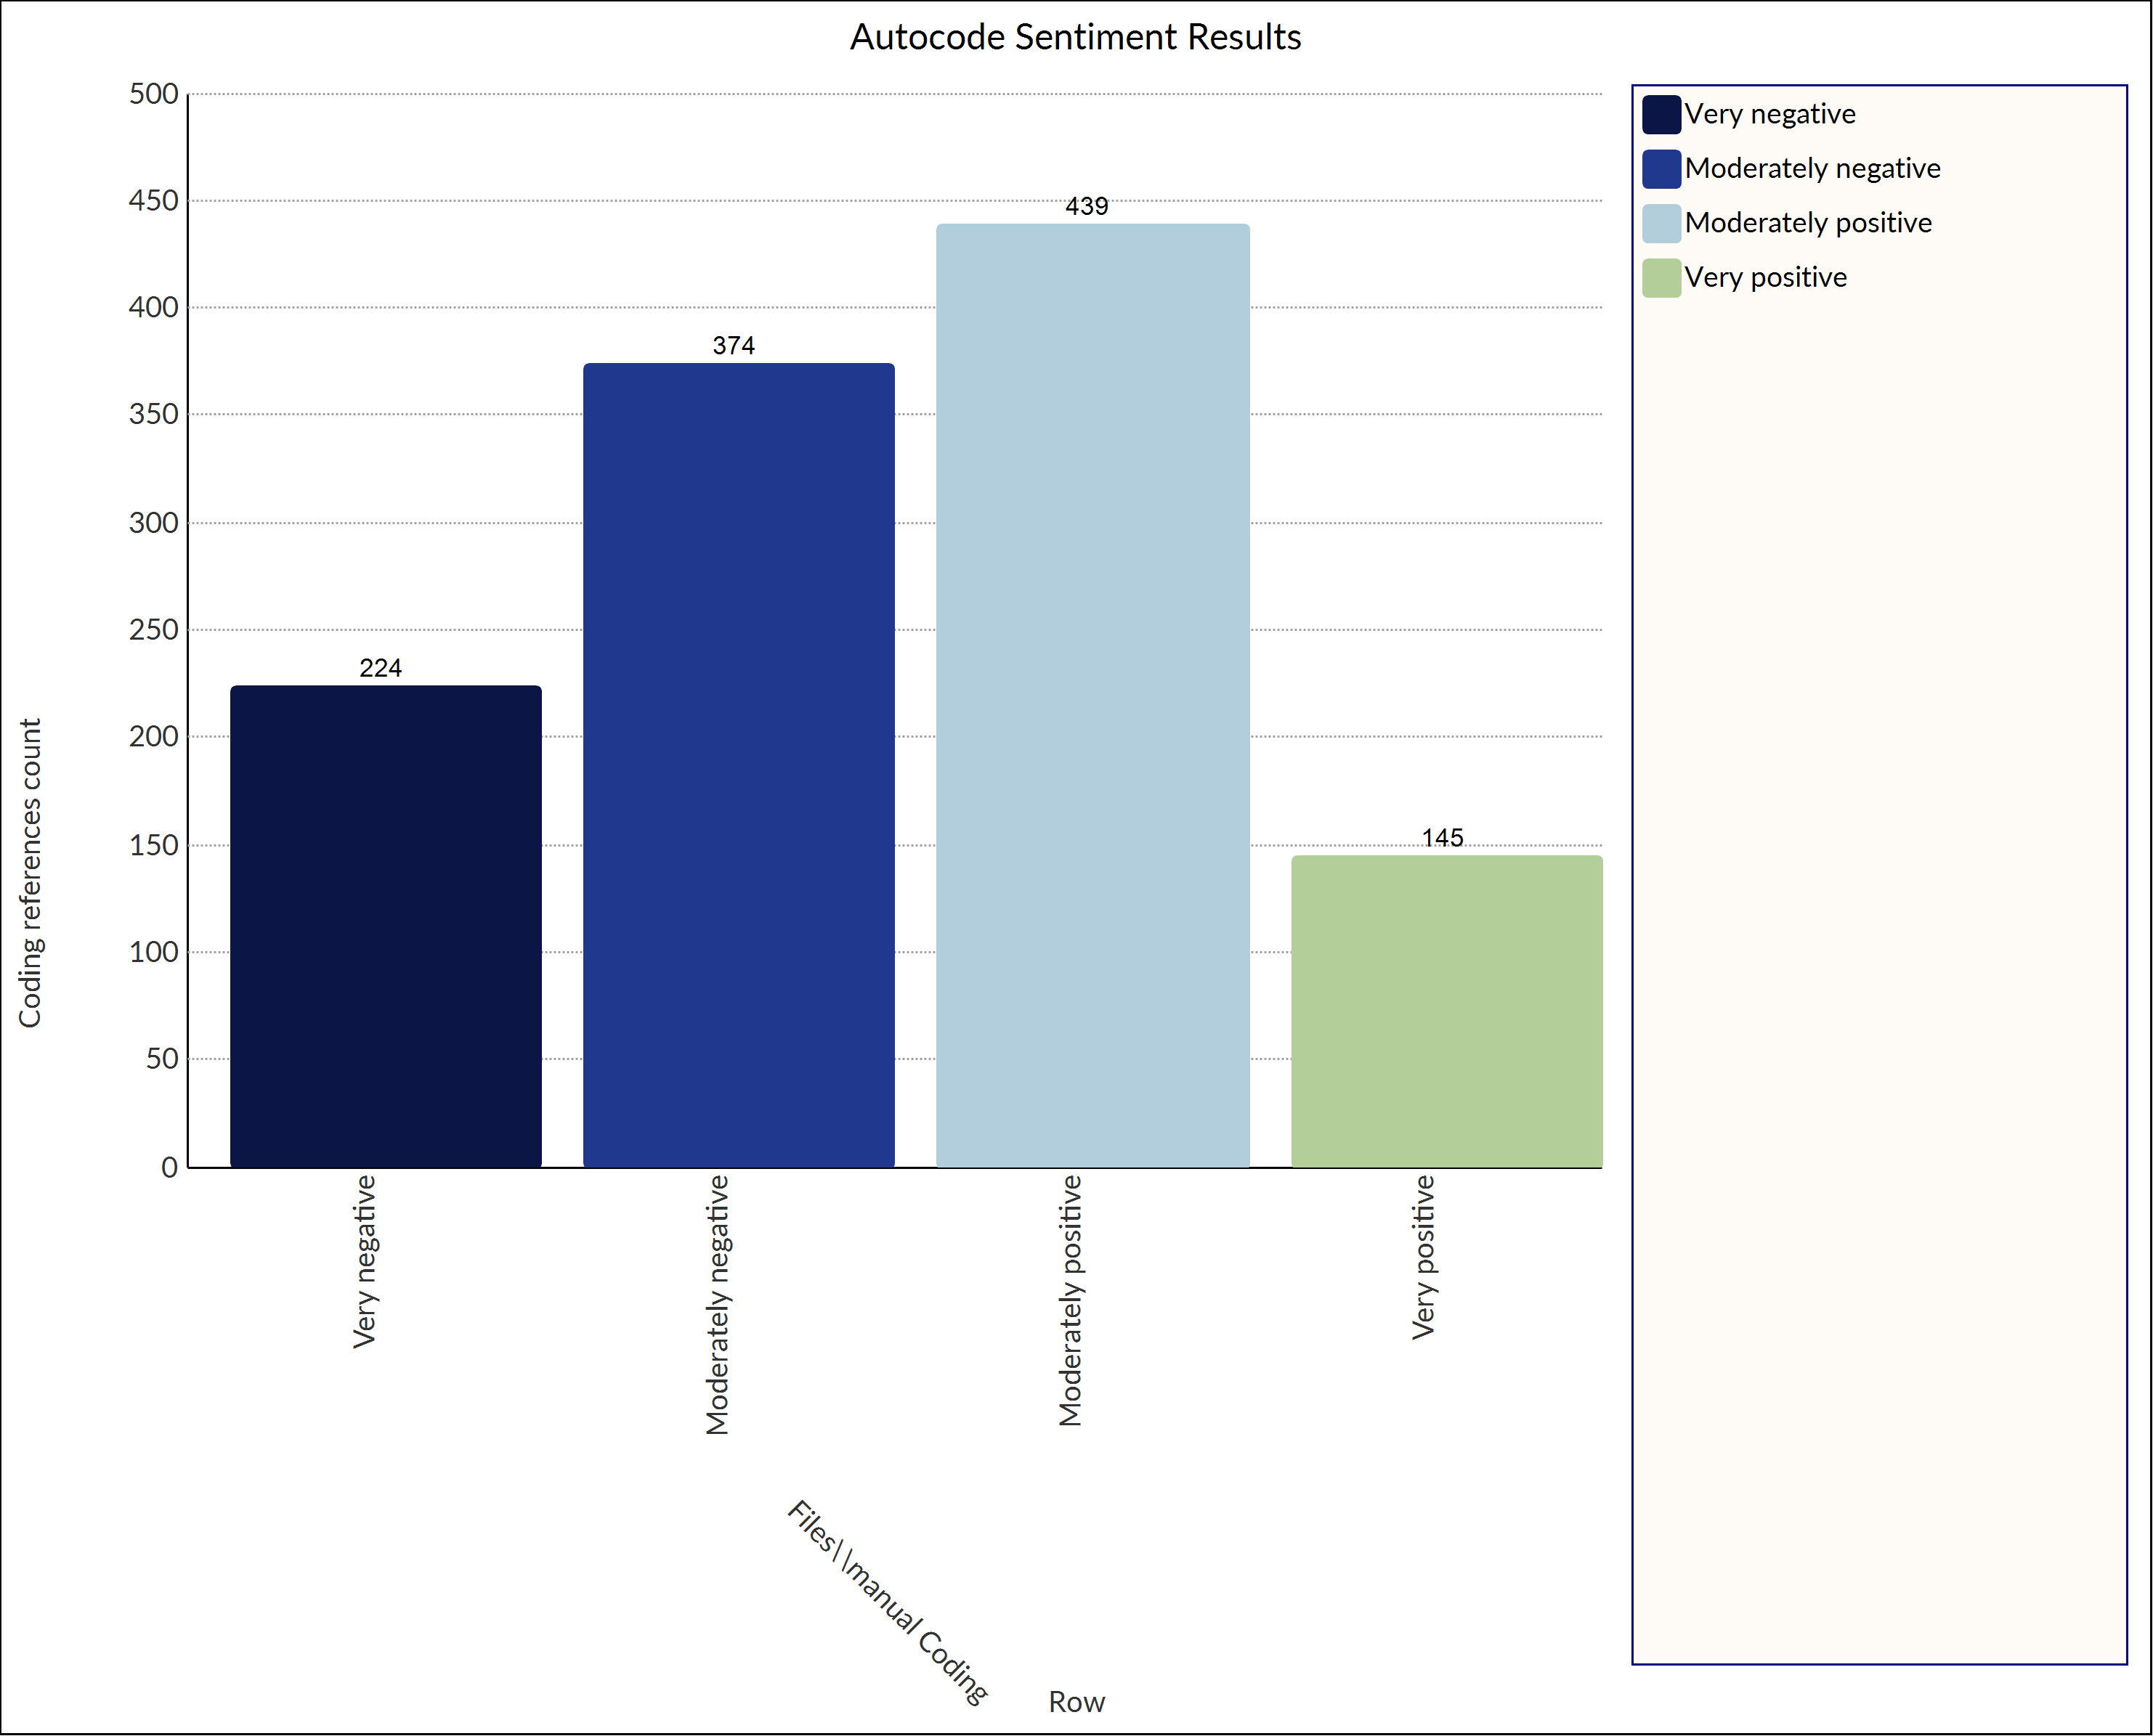
Sentiment
Autogenerated sentiment analysis from NVivo

Slide 6
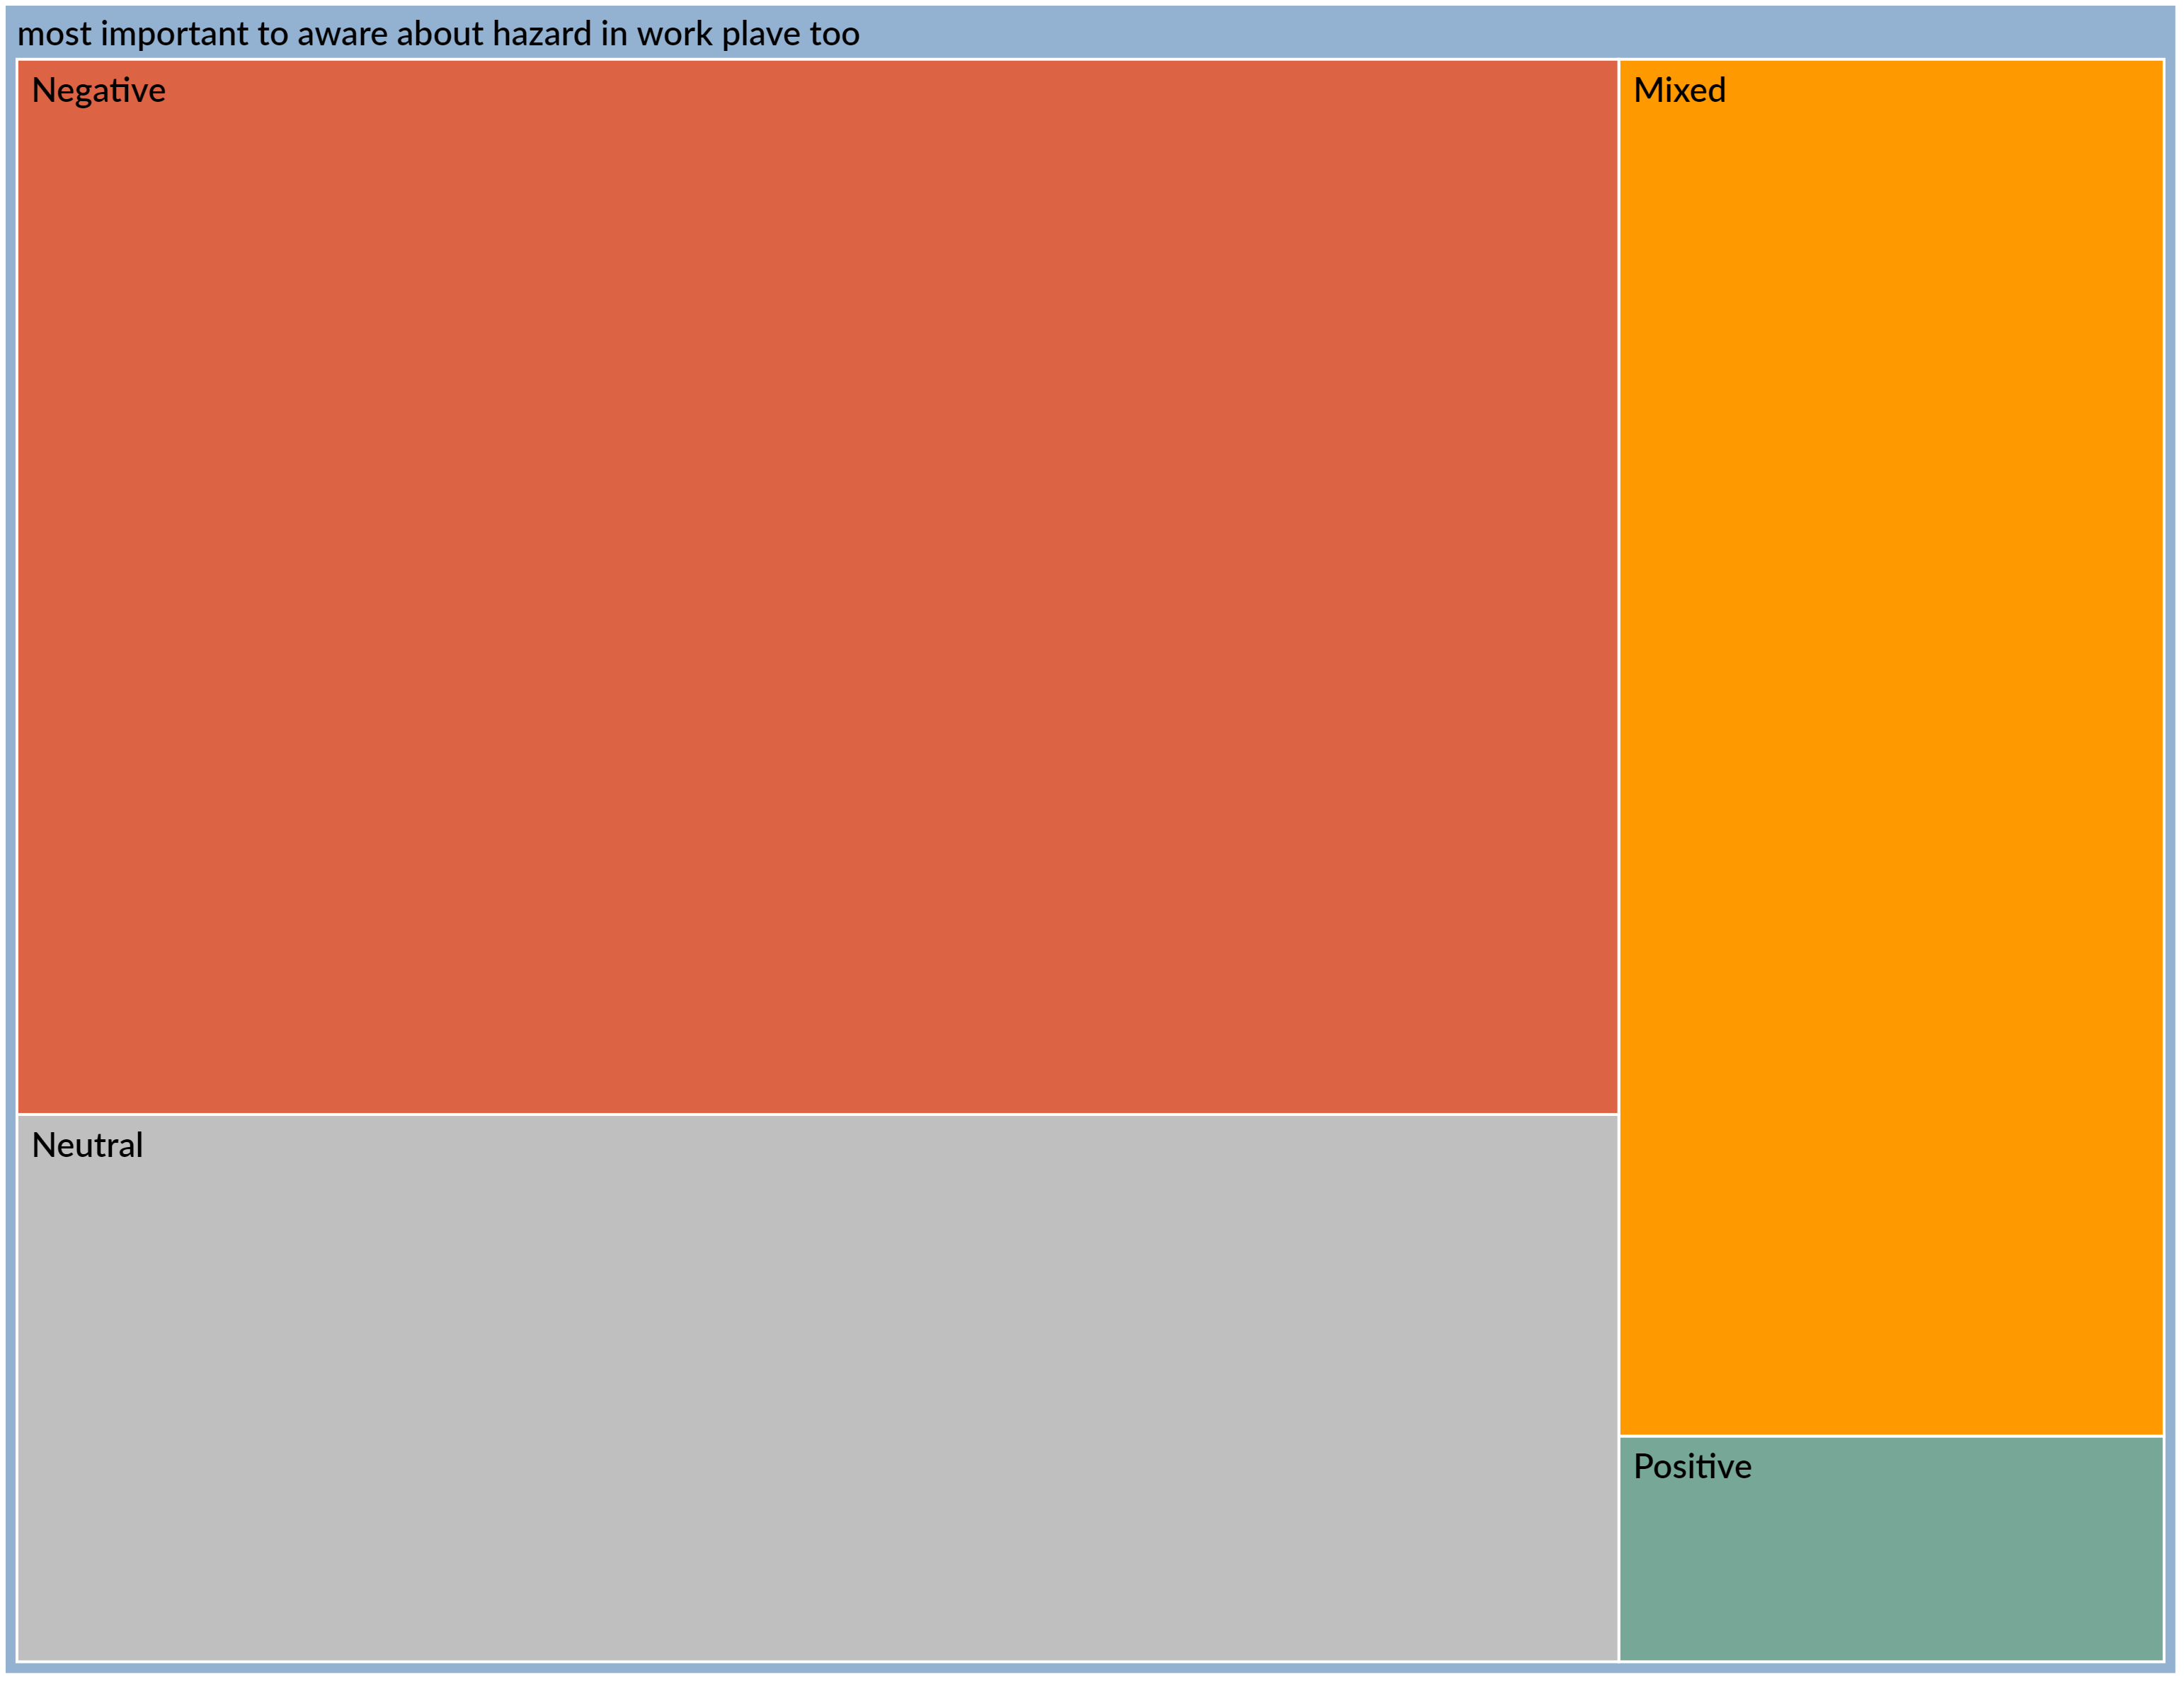
Sentiment
Autogenerated sentiment analysis of manually coded “Very unsafe” data

Slide 7
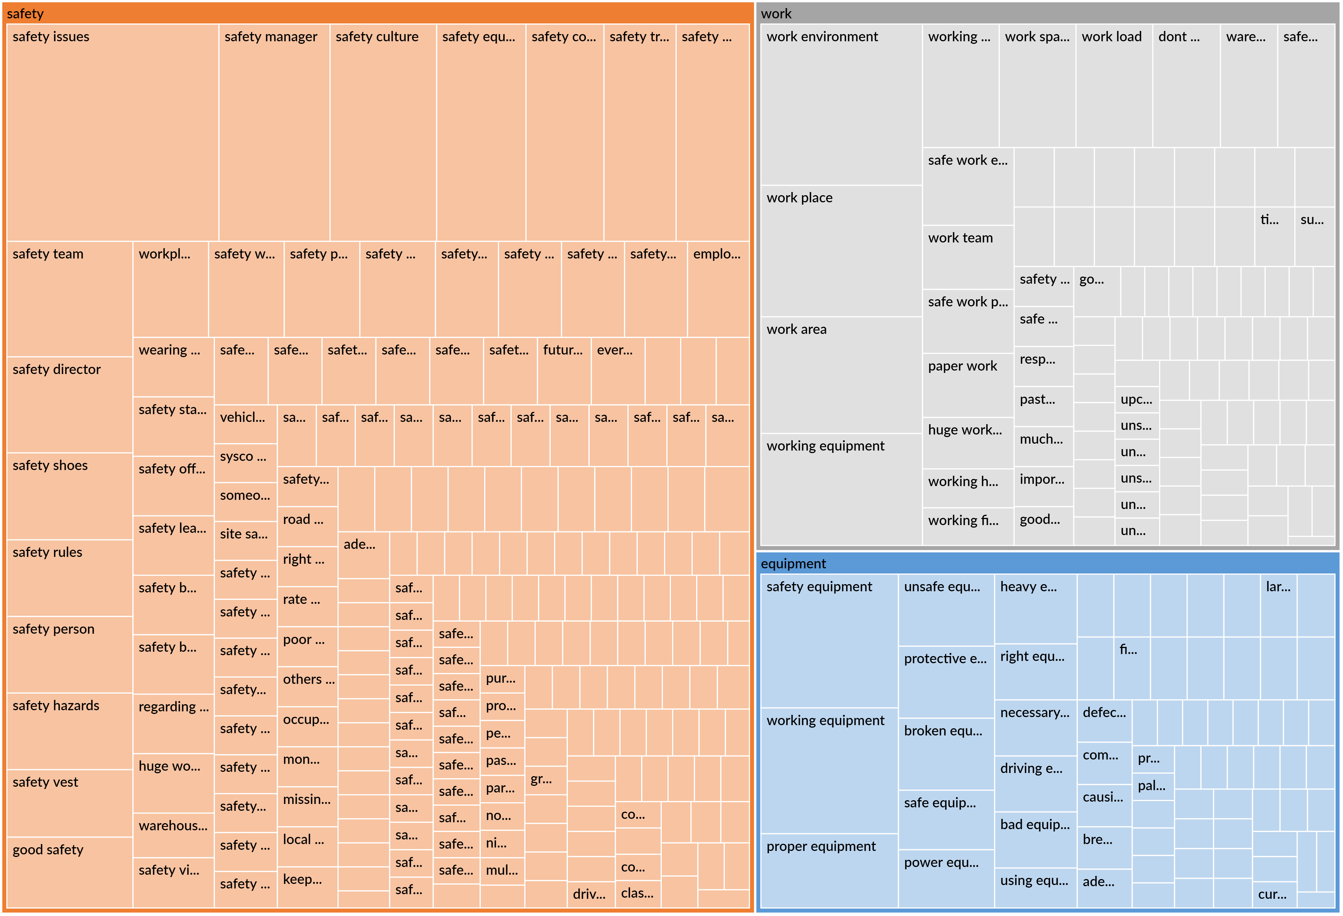
Themes
Safety
Work
Equipment

Slide 8
Safety Theme Web Chart:

Slide 9
Auto Generated Themes/Sentiment
Ethics

Slide 10
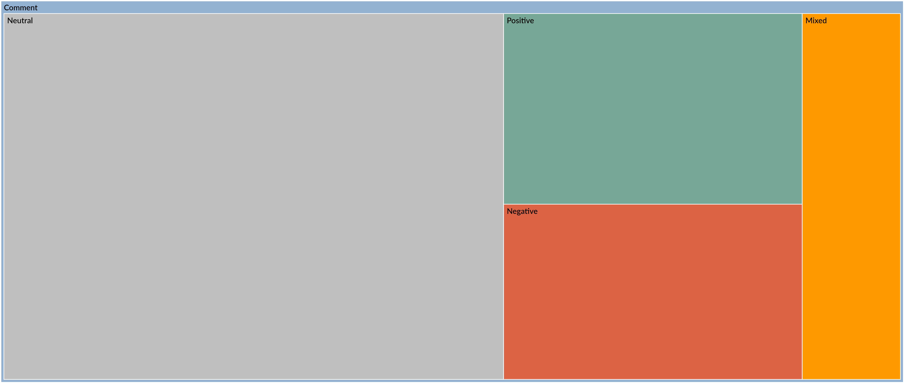
Sentiment
Autogenerated sentiment analysis of data

Slide 11
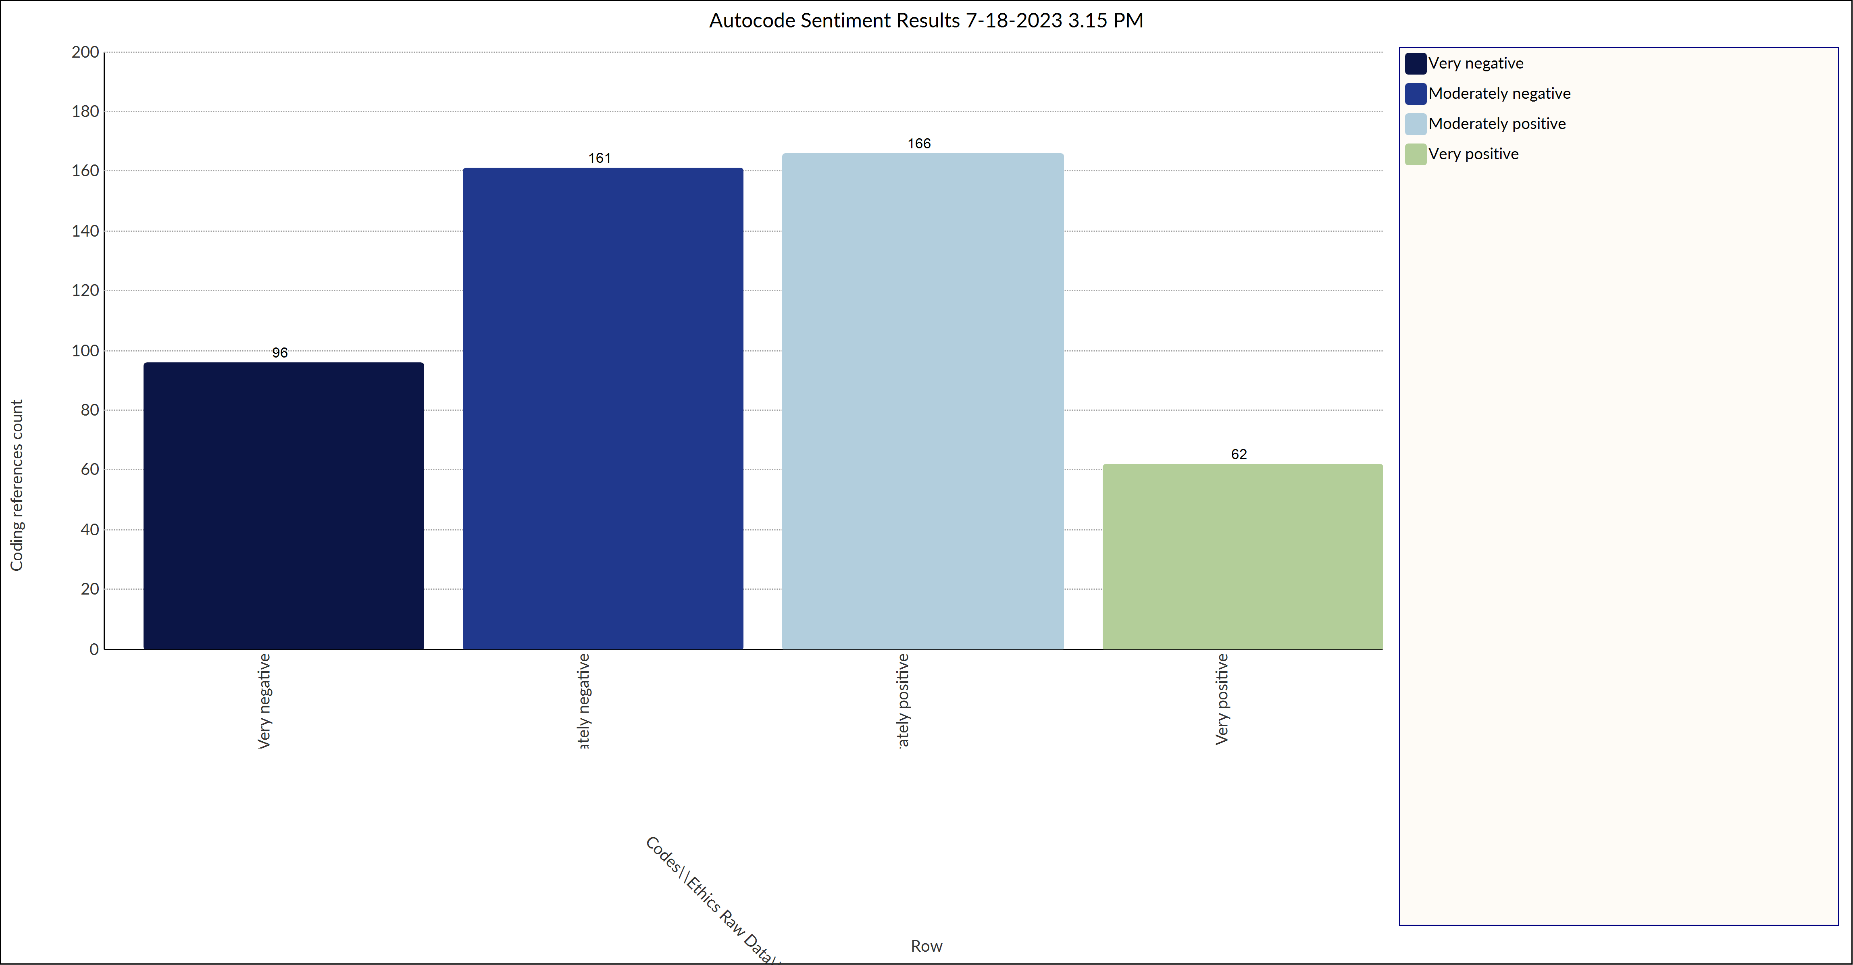
Sentiment
Autogenerated sentiment analysis from NVivo

Slide 12
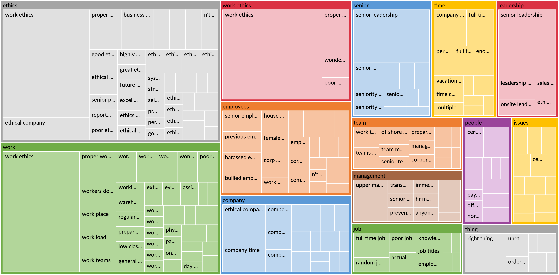
Themes
Ethics
Work
Work Ethics
Employees
Company
Senior
Team
Management
Job
Time
Leadership
People
Issues
Things

Slide 13
Theme Web Chart:

Slide 14

Combined Methods

Slide 15
Methodology
Inductive Coding
Thematic Analysis Program (NVivo)
Utilized Analysis to Create Main Themes per Dimension
Notes:
Inductive Coding
Turning qualitative data into quantitative
Inductive coding is a data analysis process that involves reading and interpreting raw contextual data to develop themes, concepts, or a process model via interpretations based on data.
Thematic Analysis Program
NVivo gives you ways to get a broad feel for what themes are in the data and it also lets you drill down into the material for deeper analysis.
Uses Machine Learning
Utilized the Analysis to Create Main Themes per Dimension

Slide 16
Safety/Ethics Themes
Combined Methods

Slide 17
Main Safety Themes
New/Rundown Equipment
Site Specific Improvements (transport/packing/loading/driving)
Not feeling heard (action)
Trainings (especially for new hires)
Accountability (management following up with employees)
Expectations (productivity more important than safety)
Common theme related to Perceived Reactionary safety measures
(A lot of comments talking about safety being an issue only when someone is injured)

Slide 18
Main Ethics Themes
Good ethics
Bad ethics
Improvements/Concerns:
Management relations (being held accountable)
Among coworkers
Trainings
Policies
Organization wide
Biases (Racial, In-group)
Work ethic
generational

Slide 19


Alternative Programs

Slide 20
NVivo
Thematic Analysis
Helps with the analysis of qualitative & quantitative data
Although the system requires multiple methods to understand themes, one advantage is that it allows data analysis on mixed research methods - qualitative & quantitative.
Organizes and codes multiple data sources in one central project.
Autogenerates themes within data. With the ability to analyze surveys, transcripts, interviews, and academic reports.
Useful, but requires additional resources
Good for quickly analyzing data, but the output does not allow for easy export, chart/dashboard creation, or further analysis into coded themes
Learning Curve
Unlike the other programs used, the user interface takes a greater knowledge threshold. With most functions within the program taking a certain level of experience.

Slide 21
Qualtrics
Topic Modeling
Turn text responses into insight
With Text iQ, you can uncover the most actionable insights from surveys and open text responses. It instantly analyzes documents so that you can understand what, in your employees’ own words, matters most.
Make data-driven decisions and predict what happens next
With Stats iQ, you can uncover meaning in data, hidden trends and produce predictive models. Stats iQ automatically runs the right statistical tests based on what you want to achieve and then translates the results into simple language that anyone can put into action.
Benefits of Topic Modeling
Mine relevant information at scale
Real-time analysis
Consistent understanding of data
Notes:
Make data-driven decisions and predict what happens next
With Stats iQ, you can uncover meaning in data, hidden trends and produce predictive models (e.g. models that can predict what would affect customer satisfaction). Stats iQ automatically runs the right statistical tests based on what you want to achieve and then translates the results into simple language that anyone can put into action.
Benefits of Topic Modeling
Mine relevant information at scale
Rather than sift through a large database of information — from social media posts to customer service emails — you can automate the text mining process using topic modeling algorithms. It’s fast, accurate and scalable, meaning you can evaluate as much data as you want.
Real-time analysis
By combining topic modeling with other types of NLP, such as sentiment analysis, you can close gaps across your touchpoints to get a complete picture of the user experience. More importantly, because the whole process is automated, you can turn insight into action whenever, wherever.
Consistent understanding of data
As you can extract meaning from your data at scale, you can understand interactions across every touchpoint, from surveys to customer feedback, and use that insight to create better experiences.

Slide 22
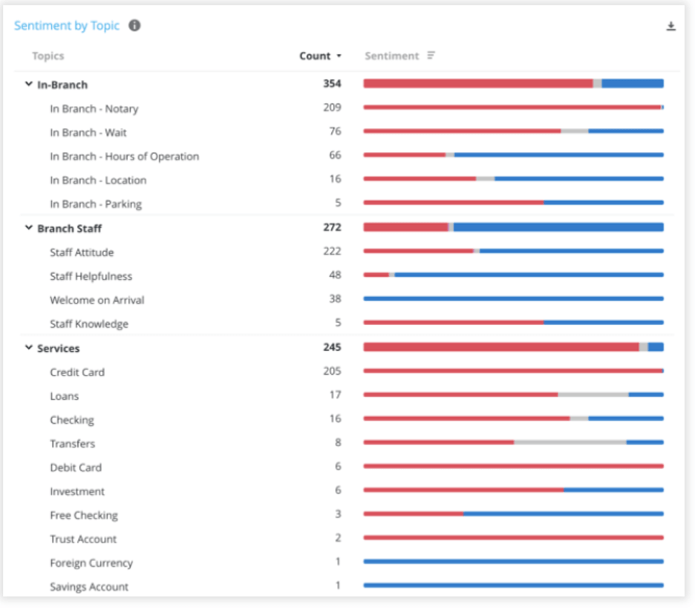
Qualtrics
Example Data
Image: Topic Modeling in Qualtrics

Slide 23
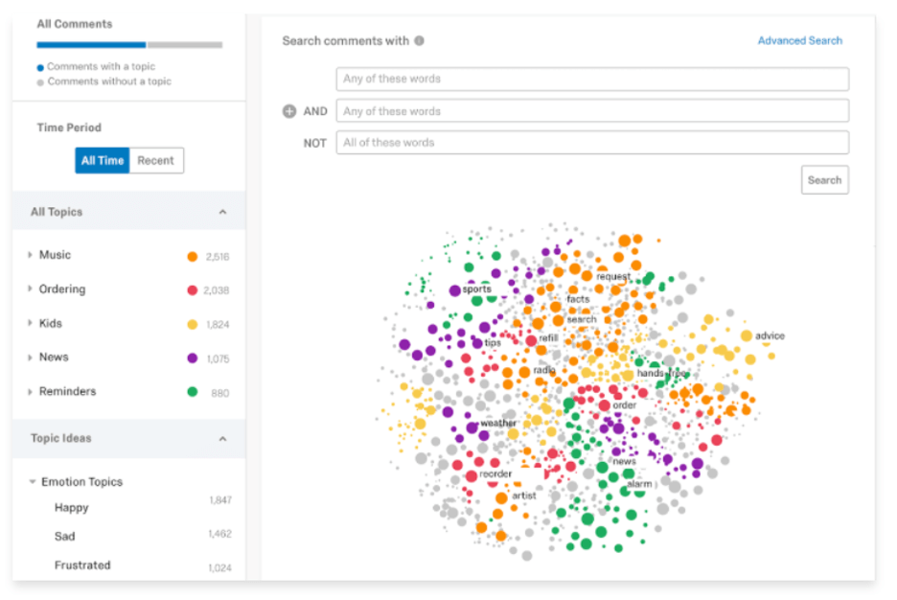
Qualtrics
Example Data
Text iQ: machine learning and native language processing to discover patterns and trends in open text

Slide 24
Thematic
Emerging Themes
Thematic discovers relationships and patterns in feedback and brings emerging trends to your attention.
Changes Over Time
Measure changes in feedback themes over time to uncover drivers and measure the impact of your initiatives.
Automate and trigger responses
Automatically recognize comments and customers that require follow-up. Trigger workflow, Jira tickets, email notifications for everything from compliance to thank you notes
Share insights easily over email or PowerPoint
Share charts and insights over email. Create stunning reports and presentations with PowerPoint export.
Dashboard Creation
Create custom views for every partner and stakeholder that highlight the most relevant patterns and insights.

Slide 25


What we Covered
Themes/Sentiment per Dimension
Auto Generated
Combined Methods
Alternative Programs
Notes:
Right click image, select ‘Change Image’ to add new photo.

Slide 26


Slide 27
Appendix

Slide 28
Safety
NEW/rundown Equipment is a major focus (cones, jackets, lifts, freezer doors)
“Maintenance really needs to inspect and update equipments in the facility to prevent accidents and injuries. A worker cant work without proper equipment.”
“Missing safety equipment or in poor condition.”
“As a driver we need more updated equipment to be able to do our job more safely and effectively.”
“Need more safety cones”
“We hear a lot about safety at the moment, but truck repairs (mirrors,...) are not done...”
“There can be difficulties in obtaining PPE and other items useful in ensuring safe working practice I feel as if a good percentage of MHE is faulty and/or not maintained to a reasonable standard creating hazards”
“Get new equipment”
“A lot of basic safety needs need to be fixed like yard lights, traffic cones, reflective tap/paint along fence line and hazardous places to walk.”
“Safer equipment”
“The equipment I use to WORK is super unsafe, Everything IS broken.”
“Equipment is old and run down, but we dont have enough equipment so people wont turn it equipment into the maintenance department because if they do they have no equipment to work on”
Not feeling heard (action)
“Safety is only important to this company if its cheap, anything costing substantial amounts of money that threatens meeting goals and impressing stockholders is ignored and disregarded.”
“There is no safety. It’s what the company says and that is final. No matter what you have to say how it is unsafe it does not matter”
“You can walk throughout the warehouse and find multiple safety hazards on a daily basis. You can send out emails and the hazards will remain day to day.”
“Ive sent emails about this to the ex safety director and vp of ops and all warehouse management, but no one cares.”
“Very disappointed as we all say this everyday but noone actually is doing anything about it.”
“they bring up topics in the safety meeting but when brought up they dont act on it. doors not locking, taking months to get new straps no shovel to properly get dry ice”
“And when brought up nothing is done.”
“none needed, they dont fix anything anyway”
A lot of comments about trainings and the need for new hires to be effectively taught
“supervisors need better employee relations training”
“Ive seen so many new employees that dont follow some safety protocols.”
“There are so many unsafety ethics and safety methods have been forgotten.”
“Continue. To provide safety information. Teach all new employees how to safely preform routes.”
“There needs to be more follow-up on newcomers in terms of security.”
‘There are some shortcomings in the respect of safety measures by some employees especially the new (poorly informed)”
“new hires need more training on equipment PERIOD!!!!!!!!”
“Just newer people to be more cautious”
“some guys, new guys, and tw need more training on operating equipment”

Slide 29
Safety
A lot of comments talking about management following up with employees to ensure they are following safety procedures (Accountability)
“Training for safety practicies are good, but some times nobody checking if they are even respecting them.”
“safety people should be walking around more lots of workers with ear pieces and phones in the warehouse.”
“All the videos I wactionactionatched about safety in orientation are not being implemented in the warehouse. Plus we don’t have the right equipment to do the job the way it should be done safely and efficiently.”
“Safety is not s top priority as many Osha violations exist in the warehouse stemming from immature supervisor that spend half the day on social media.”
“Our safety mananager spends most of his shift watching television in his office.”
“Align all employees from senior managers to operatives to follow security procedures to take care of our integrity”
“Accountabilty for unsafe behaviors, and safety leadership are lacking at my location.”
“As per sysco handbook safety is supposed to do inspections on eye wash stations, fire extinguishers, showers, ect. They do not perform any of these functions. They do not follow thru with training. Our equipment licences are all expired (if you even have one) The only thing they seem to do is receive accident reports (after the reports have been filled out by everyone else)”
“We need a more centric focus on safety activities. We talk the talk well, but walking it has become barely visible. Working safety leaders is a must.”
“It is preached but rarely practiced. I have witnessed many supervisors and above outside during nighttime hours with out proper reflective gear.”
“Despite training highlighting the requirement to use ladders for working at height, such as taking stock from upper shelving, we still do not take ladders seriously within the warehouse and we have not got replacements quickly enough when old ladders have been written off.”
“HAVE NOT SEEN HEALT AND SAFTY MANEGER ON SITE”
“not enough supervision presence on the floor specifically in the colder environments at sysco.”
“safety has taken a backseat in recent years. supervisors either dont pay attention to unsafe habits of warehouse workers or it seems like they dont care.”
“people are not held acountible for damageing racks and product.”
Expectations have been blamed as being more important than safety,
“time is pushing people past safety protocols”
“They only care that the job gets done even unsafely”
“Safety is a joke. You cant be safe at the speed management wants you to go at. You can be safe or get your precent but not both.”
“Many people at work dont take safe serious especially the people whos on percent they just tryna make the percent and money and its making them move faster witch cause accident and warehouse damage and then yall look at them crazy but it really be how yall got the system witch make them move like that. Its a safely problem.”

Slide 30
Ethics
Good ethics
I believe Sysco to be a highly ethical company that will do the right thing!
Company ethics for the employees are better when compare with other companies in the field.
Sysco is a very ethical company.
We instill ethical leadership practices and promote that vision daily to our teams
I feel Syscos ethics are aligned with my own.
Sysco has great ethics.
I believe Sysco to be a highly ethical company that will do the right thing!
We have no ethics
I am proud that Sysco doesn't just "talk the talk", they are serious about Ethic Training and that all concerns are addressed and acted upon in a timely manner.
we are always well trained with our code of conducts "ethics"
Everyone is inclusive regardless of culture or race
No issue on the business ethics and work ethic within the organisation.
Bad ethics
I feel senior leadership and immediate supervisor walk the fine line with ethics.
I believe ethically questionable procedures are not only condoned, but encouraged by certain teams in order to get ahead. (EXPECTATIONS)
You claim to be ethical, so where is it???? How is it ethical to cut pay to your hardest workers.
Our ethics need a lot of help
Work Ethics in the Fleet shop are the worst
There are no ethics, inspite of all the posters and mental health advisors. There is a culture of unproffessional favouritism and bullying, especially within the management.
Improvements/concerns
Management relations (being held accountable)
Our Opco president is taking advantage of his younger male employees and it’s no secret; it’s completely unethical and he needs to be held accountable,
Sysco is, simply put, not treating their long term employees with respect and fairness, The leadership knows it as well as the employees.
Decisions made by Senior Leadership in some instances are not ethical. Unfortunately, Senior Leadership does not believe that their colleagues are competent to distinguish what is or isn't ethical resulting in a Senior Leadership that is confident in making unethical decisions
It is apparent that there is no oversight or accountability to reduce bad or unethical practices within the Sales department to a reasonable level as issues have grown significantly over the years including within Sales leadership.
I feel senior leadership and immediate supervisor walk the fine line with ethics.
I feel that senior leadership did not operate in an ethical manner towards me
Some of the comments That senior leadership will make to And associate are Harsh , insulting, And hurtful.
Be honest to your team and that is not done by senior leadership here.
the managerial team including the supervisor needs to treat us with respect and not think of us a low class worker coz our job is hard.
Decisions made by Senior Leadership in some instances are not ethical.
There is very unethical things done by supervisors

Slide 31
Ethics
Senior employee working conditions
What are you doing to retain your hardworking veteran employees?
Improve the pay for sales employees!!... Put in a scale of seniority for rewarding or encouraging employees to stay with the company
Stop catering and being scared to treat this young generation like you treat senior employees. (DIFFERING)
The ethics in question are good route assignments going to select drivers based on a buddy system, and not on seniority or work performance!
Among coworkers
John Camilleri sexually touching and pushing himself on female employees, multi women at Sysco have stories of the same thing happening with John after evening work outings.
It’s sad when some have ethics and you find out others don’t as you read their TEAMS conversation and see they are talking bad about you on company time.
Trainings
I believe Sysco needs to highlight respecting personal space and not asking personal questions on the Ethical Policies training or create training for this. As well as, creating an environment where this is respected and appreciated. It has become the norm to assume inclusiveness means being open about private personal matters and ask others private questions such as health, family, religion etc. even when it does not apply to the subject at hand.
Periscope is a joke. They have us take integrity and ethics training. They need practice what they preach.
I am proud that Sysco doesn't just "talk the talk", they are serious about Ethic Training and that all concerns are addressed and acted upon in a timely manner.
no basic training for new hires, no knowledge of general standards and practices & requests to avoid or bypass approval or audit requirements.
Work ethics should be more focus and follow up training done'
Management issued me a warning letter for not using the safety lip w/o ever coaching or training me. This was done after 8 years of not using it, even in the presence of multiple management personel
Policies
Maternity leave (appears poor by today's standard - how does this empower and support 'typically' female employees?)
Sysco needs to implement a better absence system. Just to note this is no reflection on wider or immediate management but the company policy itself. The current system is awful and is dated and does not fall in line with the company’s supposed ethos of caring about health
It is highly unethical to provide colleagues a new insurance plan, claiming there would be no change to cost or major changes to coverage, when the reality of the transition was higher costs and inadequate coverage
Sysco is the only company that I have ever worked at where the vacation time is not awarded on a five year basis. I an currently in my fifth year of service but wont receive a third week of vacation until the end of my sixth year. To me, I find it unethical and definitely not in line with other companies in the area, to reward vacation weeks on six or seven year increments.
This location is a hotbed of ethical issues. From bullying to retaliation, intimidation to unequal imvplementation of policies.
Organization wide
, if there is no ethics inside it, that will be reflected on the outside which makes us look like a divided team, this is something that is affecting Sysco Panama
the senior leadership only promotes friends.

Slide 32
Ethics
Biases (Racial, In-group)
Many minorities are warehouse employees with very low percentage in sale or upper management
It's very obvious that skin colour is a factor when they hiring any management or senior management roles.
? ethics-----it seems like if you are a cis gender male., you are not valued or respected completely.
I do believe there's an opportunity to provide additional L & D when it comes to " Unconscious Bias ". More specifically " Confirmation Bias ". It's my opinion that often there is a tendency to search for, interpret, favor or recall information in a way that confirms or supports one's prior beliefs when it comes to an evaluation of a colleague.
People within the company are receiving disciplinary action against them based on bias opinions from upper management, two people could make the exact same mistake and have two different outcomes i.e disaplinary action for one and things being swept under the rug for the other again based on bias from upper management
there are people getting disciplinary against them and other people are not for doing the same thing and then other people are not even getting disciplined for some of the things that they do its as if management is biased towards some people
Our Local ELT team is more concerned with promoting a race and/or a gender, than the best candidate for the position. Yes, this is a goal of our company. It should be equitable but not to the point that we put a race or gender ahead of all other consideration.
Work ethic
Some employees have poor work ethic and do not clean up a mess they made at the end of a shift. (WORK ETHIC)
Make sure our colleagues understand the importance of their work ethics. As simple as been on time, follow the PWM to avoid the hurt on our service level, the importance of caring for the case (damage) and how unacceptable is to not to. Making sure everybody understands what our goal and our standards are, and the consequences of not thriving to be part of the team. (training)
Ties in with what I said previous peoples work ethic drive commitment wanting to doing things right. Quality over quantity that type of thing simple everyday things that can change
Some employees have poor work ethic and do not clean up a mess they made at the end of a shift.

